Slide 1
APEX UX Review – Pt. 5
By Jodi Kuehn (Keen Eye Design)

Slide 2


Agent Services:
Revisited
OMG! You’ve been busy!
This is fantastic – you should be proud of all the work you’ve done here!
I love the clear steps and process outline. It makes a lot more sense now – so easy to follow and understand!

Slide 3

Agent Services:
A few minor tweaks
Agent Services main page:
I love the number sequences on your LANE pages – so on this intro page, let’s change “Step 1” to “Start Here.” That way the sequencing makes more sense on the following pages.
I know you said you can’t change the size of the ”Pick Your Lane” text, but can you change the color? Using orange will help call it out, and differentiate it from the Lanes below. If possible, maybe add a bit more spacing between the “Start Here: Pick Your Lane” text and the Lane headers below.
1

Slide 4
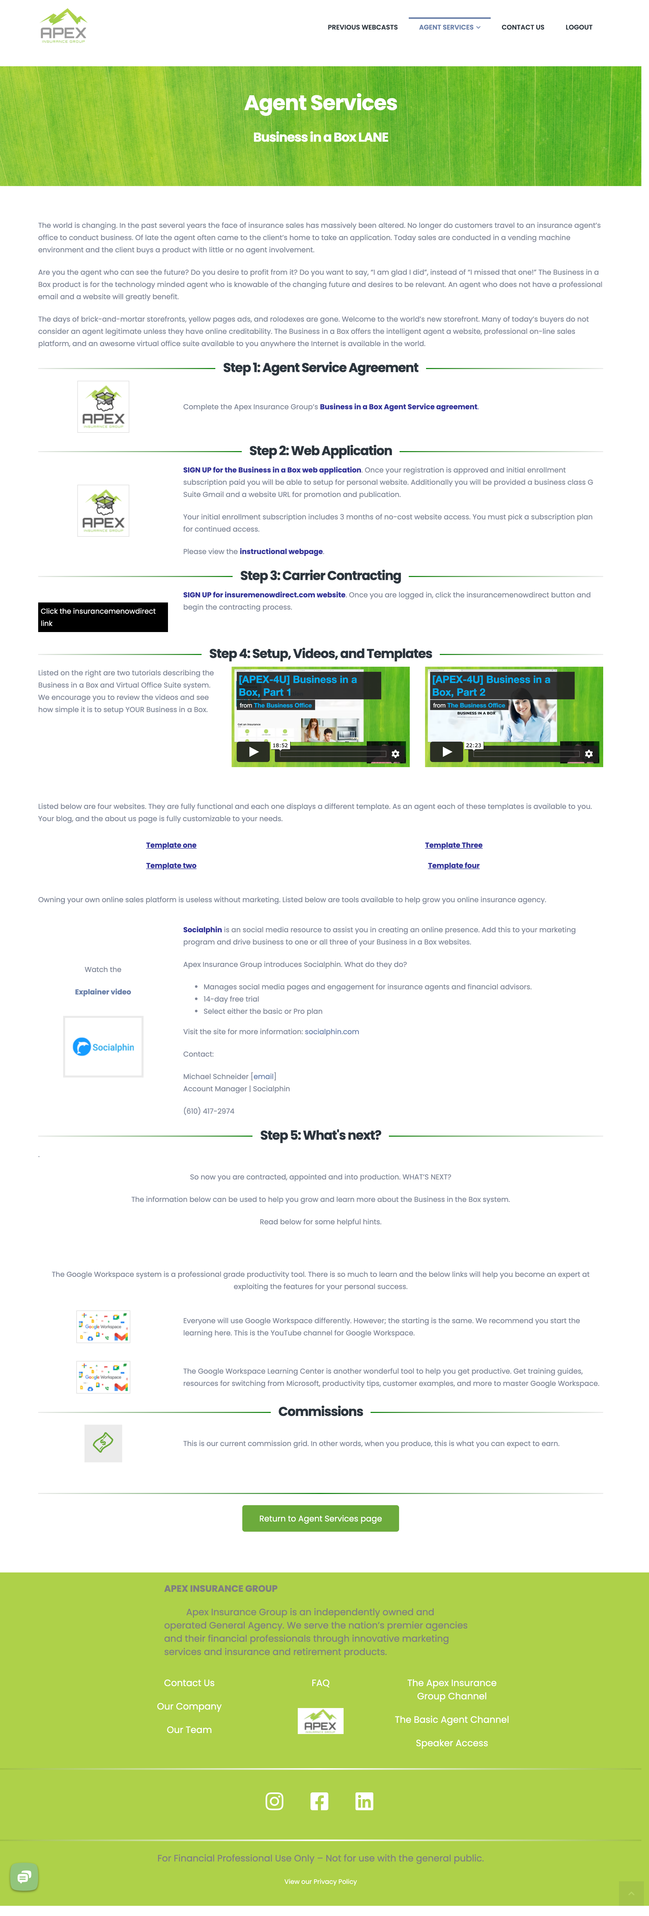
Business in a Box:
A few minor tweaks
Of late the agent often came to the client’s home to take an application. Today, sales are conducted…
Rewrite:
Nor are agents going to the client’s home to take an application. Today, sale are conducted…
1

Slide 5
Business in a Box:
A few minor tweaks
Do you want to say, “I am glad I did”, instead of “I missed that one!” The Business in a Box product is for the technology-minded agent who is knowable of the changing future and desires to be relevant. An agent who does not have a professional email and a website will greatly benefit.
Rewrite:
Do you want to say, “I am glad I did,” instead of “I missed that one!” The Business in a Box product is for the technology-minded agent who is knowledgeable of the changing future and desires to be relevant. This service is best for agents who do not already have a professional website and email.
2

Slide 6
Business in a Box:
A few minor tweaks
Add: Step 5: Marketing
Change: Step 6: What’s next?
Be consistent: Either capitalize One, Two, and Four, or make “three” lowercase to match the others.
5
3
4

Slide 7
Business in a Box:
A few minor tweaks
6.1
6.2
Duplicate messaging here – pick one of these two sentences and remove the other to keep it simple.
Add text link: This is our current commission grid.
It’s fine to have the image also be a link, but don’t have images be your ONLY link. Always have a link in the text to accompany any image links.
7

Slide 8

Federal & Postal:
A few minor tweaks
The federal and Postal Service lane…
Rewrite:
The Federal and Postal Service lane
a Windows based laptop is also required for this market.
Rewrite:
A Windows based laptop is also required for this market.
1
2

Slide 9
Federal & Postal:
A few minor tweaks
The reward is once the bubble is pierced then the reward is superb. The biggest payoff is life-long clients. Available products are: short-term disability, life insurance, supplemental savings, and annuities. These are all available in the federal and Postal Service marketplace. The active, system- following, active agent maintains a comfortable income of about $160k annually.
Rewrite:
While it’s more involved than other groups to start, once the bubble is pierced, the reward is superb. The biggest payoff is life-long clients. Available products are: short-term disability, life insurance, supplemental savings, and annuities; these are all available in the Federal and Postal Service marketplace. The active, system-following agent maintains a comfortable income of about $160k annually.
* Great use of text links on the rest of this page! Kudos!
3

Slide 10

Final Expense:
A few minor tweaks
With the aging U.S. population, final expense insurance is becoming more of a necessity than ever before.
Rewrite:
With the aging U.S. population, Final Expense insurance is becoming more of a necessity than ever before.
The final expense market is for the agent who desires a lead-driven business model.
Rewrite:
The Final Expense market is for the agent who desires a lead-driven business model.
The final expense market is growing.
Rewrite:
The Final Expense market is growing.
1
2
3

Slide 11
Final Expense:
A few minor tweaks
4
Add your text links o this page, like you have on the others.
Make this link bold like the others.
5
4

Slide 12
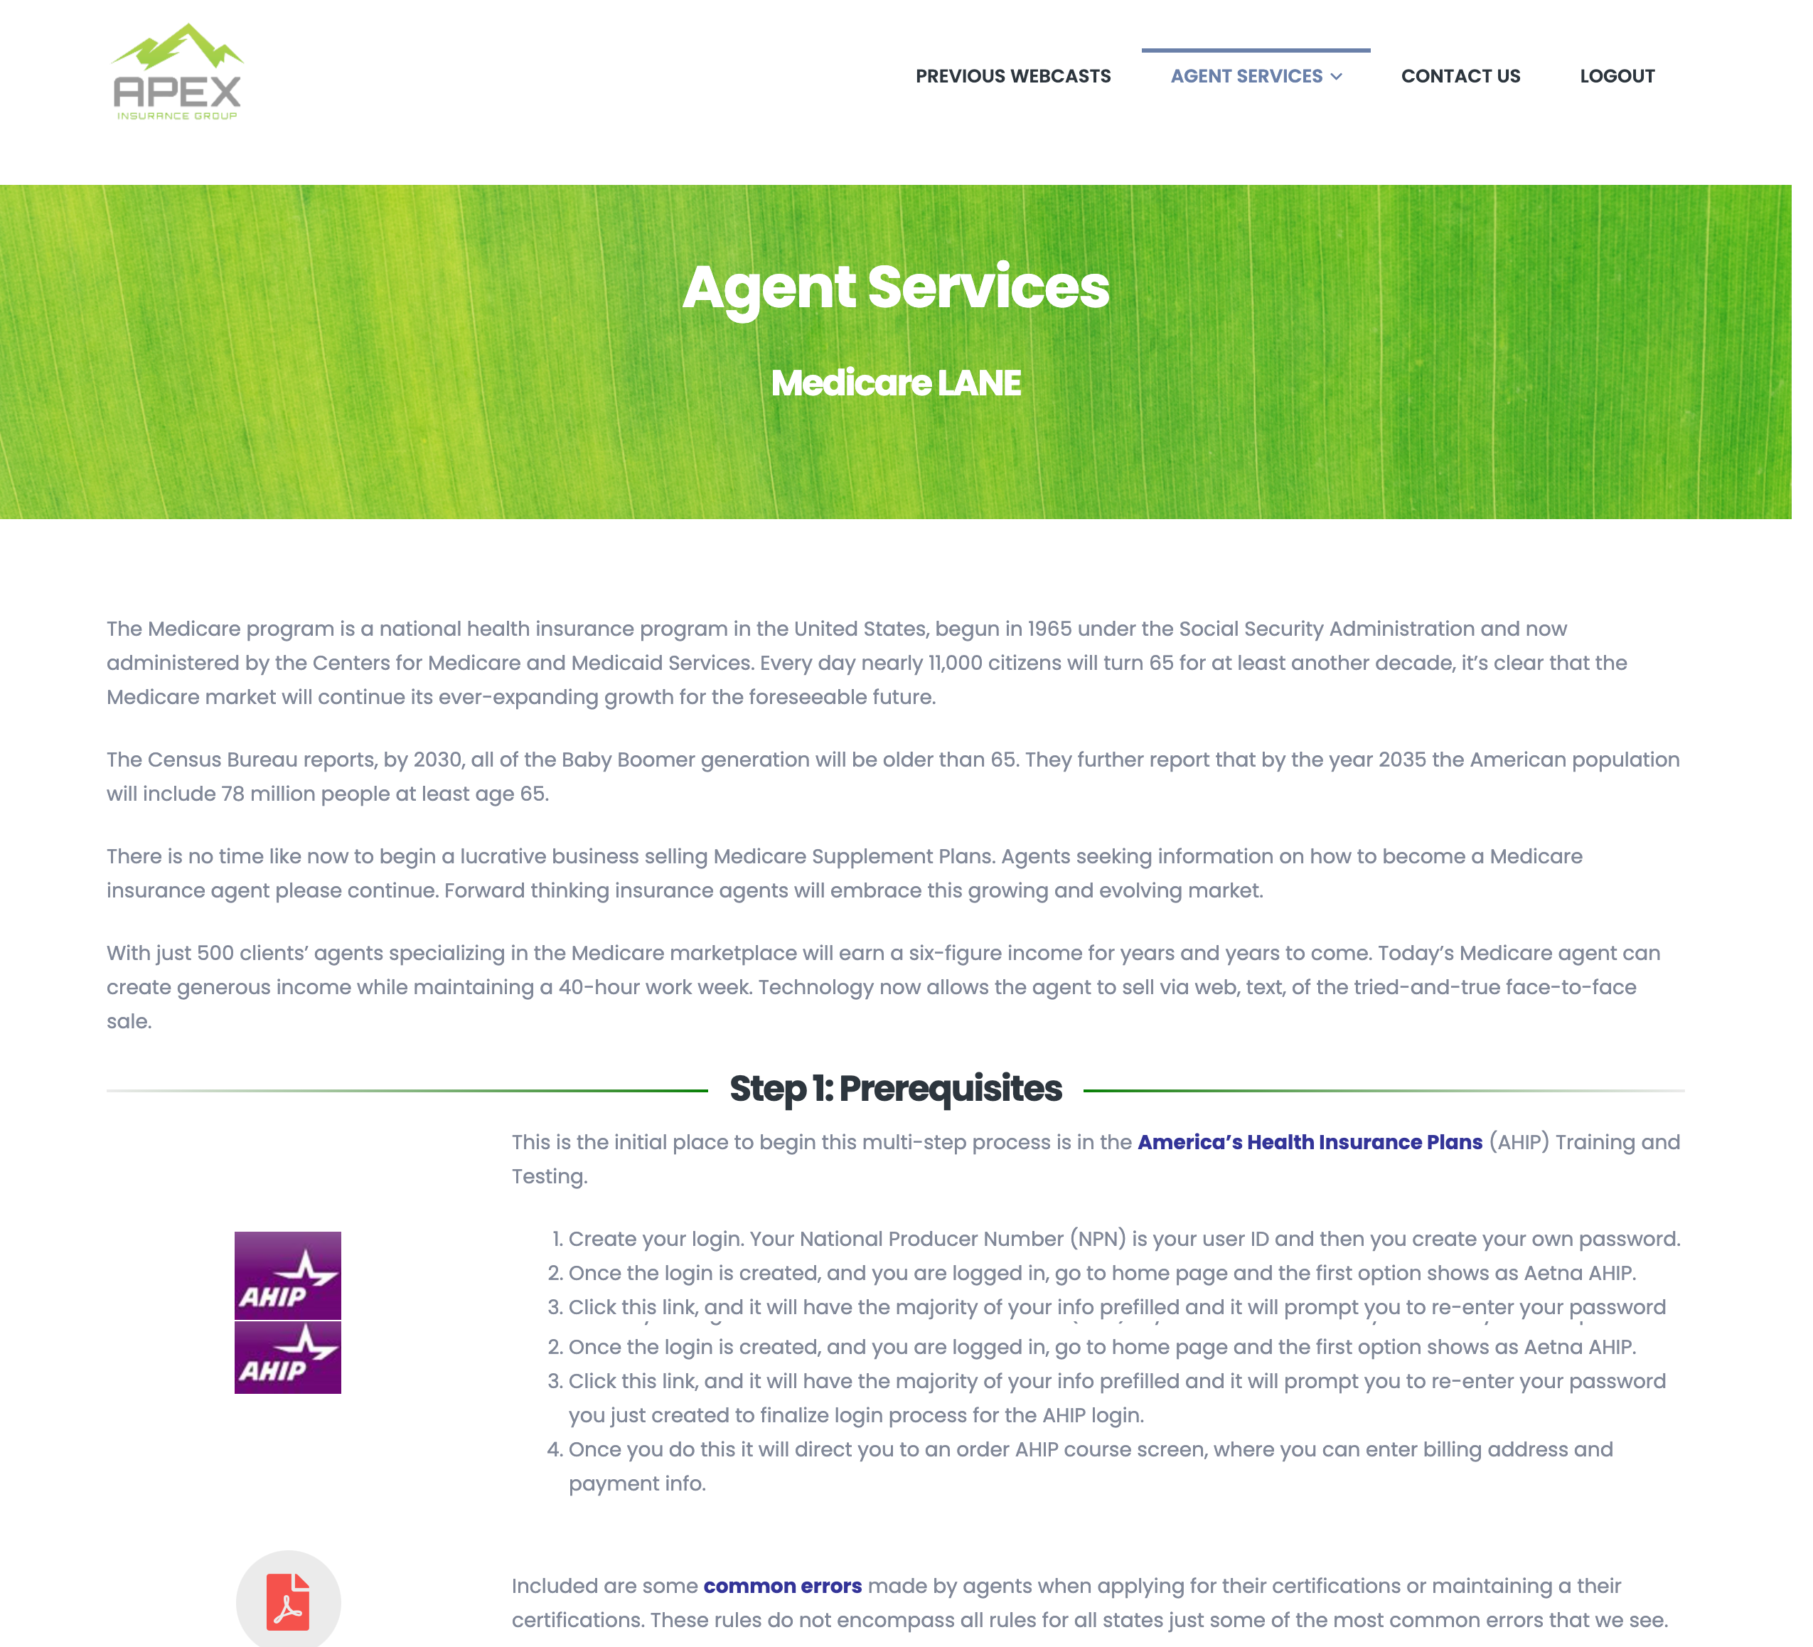
Medicare:
A few minor tweaks
Every day nearly 11,000 citizens will turn 65 for at least another decade, it’s clear that the Medicare market will continue its ever-expanding growth for the foreseeable future.
Rewrite:
With nearly 11,000 citizens turning 65 every day for the next decade, it’s clear that the Medicare market will continue its ever-expanding growth for the foreseeable future.
Forward-thinking insurance agents…
Rewrite:
Forward-thinking insurance agents…
With just 500 clients’ agents specializing…
Rewrite:
With just 500 clients, agents specializing…
1
2
3

Slide 14

That’s all I’ve got!
Thank you for being so awesome and totally on top of all the suggestions and changes – I hope you’re able to see a positive impact on the Apex website!
It’s been a pleasure doing business with you, John! Please let me know if there’s anything else I can help with.
-- Jodi Kuehn
Keen Eye Design

