Slide 1
APEX UX Review – Pt. 4
By Jodi Kuehn (Keen Eye Design)

Slide 2
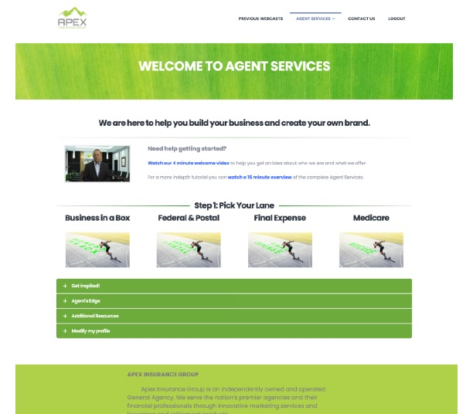
Agent Services:
Landing page
Looking so much better, but 2 tweaks recommended:
Keep the font hierarchy going – make the headline “Step 1: Pick Your Lane” stand out by making Business in a Box, Federal & Postal, Final Expense, and Medicare a smaller (but still bold) font. (Like the “Need help” sub-headline.)
Fix the typo on “Get Inspired” ;-)
Fix grammar and punctuation on “Check out these video interview with our partners” – add “s” on ”interviews” and a colon after partners.
Good grammar and punctuation = trustworthy business!
Kudos on making the links much more accessible and SEO friendly! They look awesome!
1
2

Slide 3
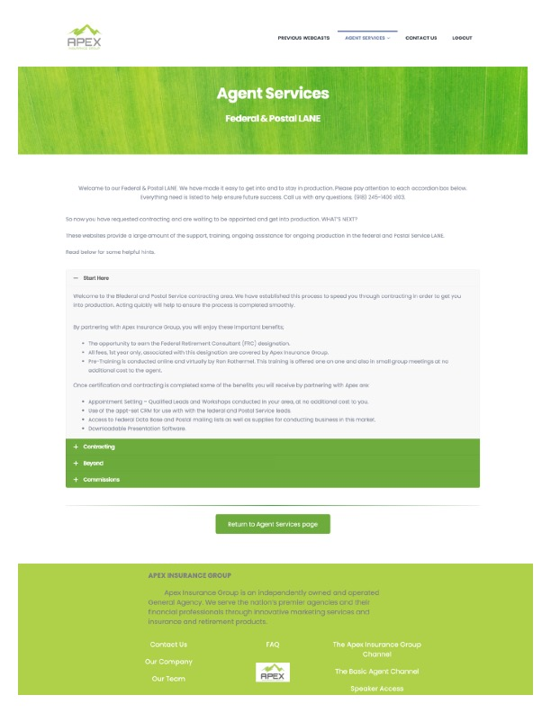
Agent Services:
Federal Lane
On the previous Agent Services page, customers are warmly welcomed and guided to Step 1 – I don’t think you need to welcome them again on the Lane pages; they’ve already begun the process, so the goal here is to guide them through the next step(s).
The intro copy here should focus on WHAT the Federal & Postal lane is, WHO it’s for, and WHY agents should pursue this lane.
We designated Step 1 on the Agent Services landing page. We need to continue that flow on the Lane pages.
Accordion says “Start Here” but there’s nothing to do in this section.

Slide 4
The following is a complete outsider’s view of the process for signing up with all APEX lanes.
Ideally, ANYONE with ANY background (even those with no knowledge of insurance) should be able figure out the process for getting started
(without having to read a lot of fine print).
For the record, I didn’t dive into all the videos, which may or may not explain things in greater detail.
Don’t rely on videos to relay important sign-up processes.
Give your clients an initial checklist, and let the videos serve those that want greater depth into a topic.

Slide 5

Agent Services: Business In A Box
From what I can gather, these are the steps to getting started with this lane:
Step 1: Complete the Apex Insurance Group’s Business in a Box Agent Service agreement.
Step 2: SIGN UP for the Business in a Box web application.
Step 3: Setup your personal website (after registration is approved and initial enrollment subscription paid). (View video demos for assistance.)
Step 4: A Gmail email and a website URL provided for promotion and publication.
The “Getting Started” accordion section should come before the “Information & Setup Tutorial.” (Or be imbedded in Step 3.)
The page could be organized and labeled better, but I generally understand the set-up process and it’s not too confusing.
Usability Grade: B-

Slide 6

Agent Services: Final Expense
From what I can gather, these are the steps to getting started with this lane:
Step 1: Apply to the Delta Dental program (?)
  Why am I signing up for this? How is this tied to becoming a Final Expense agent? Is this a good place to start?
Step 2: Enroll in PNC Hub (?)
  So, agents are paid a referral fee for each completed P&C quote. But what is P&C, and why should I care? (Video explanations are great, but give me a quick reason before I dive into the video.)
Step 3: “The initial contracting request will be the “Prosperity Life” product. A great product for heart healthy clients. The carrier offers Level, Graded, and Modified opportunities.”
  Great. Shouldn’t this be first in the list if this is the default product I get with the Final Expense lane? How do I get this ”Prosperity Life” product? What do I need to do here?
Step 4: Some sort of Levinson thing (?)
  Why am I being transferred here? What exactly am I supposed to be doing here?
There are some links here, but I’m confused about the process and why I’m doing some of these tasks.
Usability Grade: D

Slide 7
Agent Services: Medicare
From what I can gather, these are the steps to getting started with this lane:
Step 1: Sign up for America’s Health Insurance Plans (AHIP) Training and Testing.
  Is the PDF of common errors supposed to help me with the AHIP testing? It’s not clear if I should review this before I go to AHIP or after.
  Why is the roadmap listed last? How important is this information? Is a guide, or regulation?
Step 2: Commissions (?)
  Is this informational or do I need to do something here?
Step 3: Apply to the Delta Dental program (?)
Step 4: Some sort of multiple carriers thing (?)
  I’m not sure what I’m doing here, but there’s a scary warning telling me, “Failure to follow each of the steps correctly will delay the contracting and appointment process.”
Step 5: Training & Tutorials (?)
  Is this informational, or required?
Step 1 is fairly clear, but the rest is less so.
Usability Grade: C-

Slide 8
Agent Services: Federal & Postal
From what I can gather, these are the steps to getting started with this lane:
“So now you have requested contracting and are waiting to be appointed and get into production”.
  When did I request contracting? Did I miss something? I just came to this page from the Agent Services page… what do I do next?
Ah! I see the steps now, under the Contracting accordion section. A bit buried, but now that I’m there, I see what I have to do.
Step 1a: Request to represent The Benefit Coordinators
Step 1b: “Any contracting outside of these will create a delay in the process. Click HERE.”
  What am I doing here? Where am I clicking?
Step 1c: Apply for 'Financial Lifeline’ by Occidental Life Insurance Company.
Step 1d: Complete a LIMRA AML or Occidental AML training.
  Do I need to do this BEFORE Step 1c??
Step 1e: Apply for Federal Retirement Consultant designation.
Step 1f: Register for training and testing access.
There are a lot of sub-steps under Step 1. Even if they can be done in any order, I’d recommend picking the BEST order, and number them Step 1, Step 2, Step 3, etc.

Slide 9
Agent Services: Federal & Postal (continued)
From what I can gather, these are the steps to getting started with this lane:
Step 2a: Apply for some short-term disability program (but it’s unclear which one; logo is hard to read).
  Is this optional, or required?
Step 2b: Apply for TPA Processing.
  Is this optional, or required?
Step 2c: Enroll in Central United and Manhattan Life short-term disability product.
  Is this optional, or required?
It looks like there’s more links under “Beyond,” but I’ll pause my evaluation here. Make it clear whether or not items are mandatory, highly recommended, or optional.
Other than the intro being confusing, and the main steps being buried under the second accordion, this page is a little better organized than some of the others.
The page could be labeled better, but I generally understand the set-up process and it’s not too confusing.
Usability Grade: B-

Slide 10
Agent Services: Summary
So, before I can dive in and give specific guidance on how to format your Agent services pages, I need to understand the steps for each lane. The previous screens give you a “fresh eyes” look at how your pages “read” to first-time visitors. Maybe I was able to glean the gist of each application process, or maybe I’m way off in what I determined were the steps for each lane. Hopefully my insight gives you an idea of what is ”missing” from each page in terms of how (and what) you’re communicating with your clients.

Slide 11
Agent Services: General Conclusion
Call out your steps more clearly. If items can be done in any order, pick an ideal order and number them that way.
Move initial set-up requirements/steps outside (above) the accordions, and keep the accordions for everything beyond the initial set-up
OR put the initial set-up steps in the very top accordion(s). You could potentially make an accordion for each step.
Keep re-formatting links throughout these pages to be accessible/SEO-friendly.
Watch for spelling/grammar mistakes – I’ve counted plenty. ☹
Copywriting could use some finessing to make it more concise and easier to read and understand. After the steps are defined more clearly, I am happy to work with you on some copywriting cleanup. ☺

