Slide 1
APEX UX Review – Pt. 3
By Jodi Kuehn (Keen Eye Design)

Slide 2
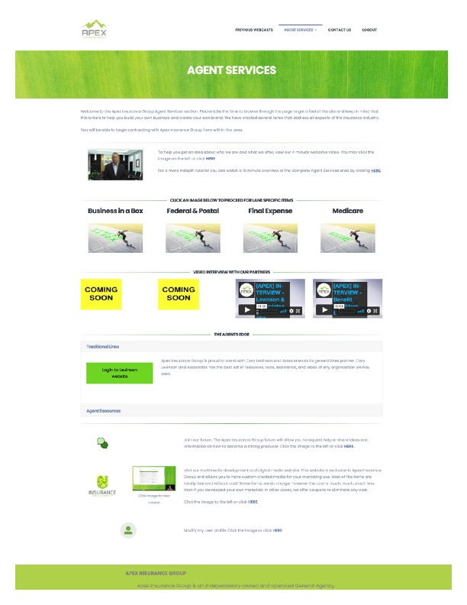
Agent Services:
Landing page
There is a lot going on with this page! Having content broken into sections with horizontal dividers is good, but the content still all blends together.
The sections have headlines, but unfortunately, those headlines get visually lost among the content because there’s no font-size hierarchy.
It’s bad form for links to say “click here” - not only for accessibility but also for SEO.

Slide 3
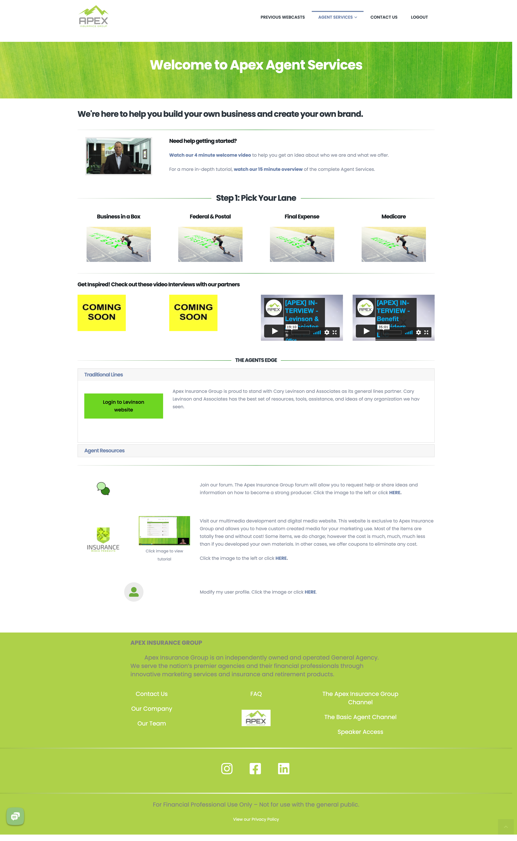
Agent Services:
Landing page
RECOMMENDATION:
People don’t want to spend a lot of time reading text online -- Keep text short and concise, and utilize font hierarchy by having headlines and sub-headlines:
Large Font Headlines followed by
Medium Font Headlines followed by
small font body copy
helps guide the reader through the page’s content, and keeps the page visually organized.

Slide 4
Agent Services:
Landing page
1
FONT RECOMMENDATIONS:
2
Welcome visitors to the page at the top. No need to have a whole paragraph in small print welcoming users to the page. Keep it simple.
Tell the user why they’re here.
Call out areas that are designed to help those that are lost or need guidance. This section could optionally go under Pick Your Lane.
  Fix links to be more accessible and SEO-friendly
Give users a clear indication on where they should start.
  Note that this font is the same as #2 on purpose; same font sizes helps group sections and guide the user to the next content area.
3
4

Slide 5
Agent Services:
Landing page
FONT RECOMMENDATIONS:
The original headline/section header here gets lost; moving it to the left helps differentiate it from your main Pick Your Lane section. Add “Get inspired!” (or something to that effect) to help indicate that this is a helper section, not the main path.
Don’t give equal font importance to sections that aren’t part of the main process. Use a smaller sub-headline font here like we did for “Need help getting started?”
5

Slide 6
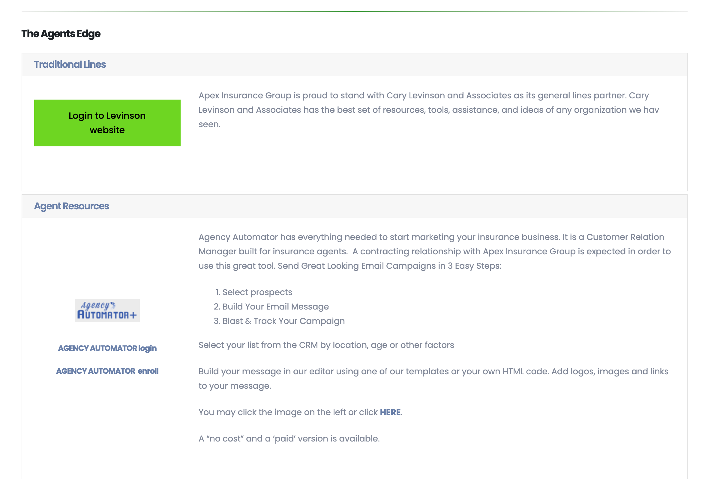
Agent Services:
Landing page
Agents Edge: I was initially confused about these expand/ collapse accordion sections. (I didn’t realize they were expand/collapse, and was confused by the blue link/gray background which was a different font treatment from the rest of the page.) By default, one section is open and the other is closed, which is an odd user-experience, being as there’s only 2 sections here.
If anything, I’d put everything below the Pick Your Lane section into an accordion, to keep focus on getting your agents through the main process.

Slide 7
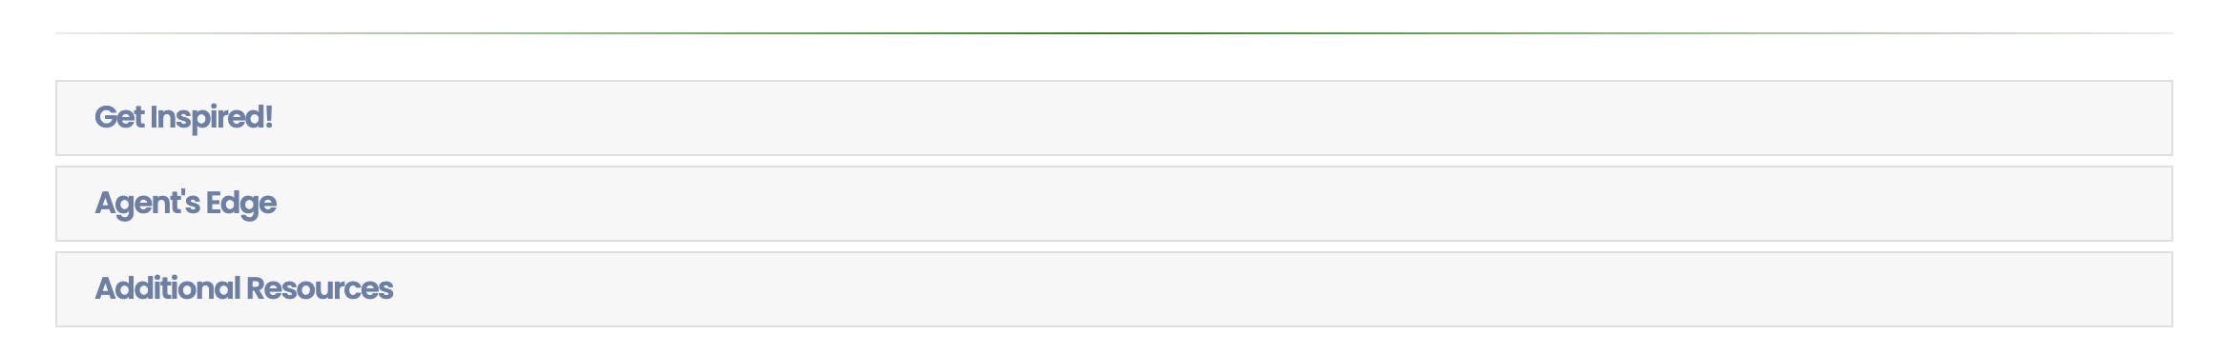
Agent Services:
Landing page
Example of all sub-content in an accordion. Keeps user’s attention focused on the main path through the process.

Slide 8
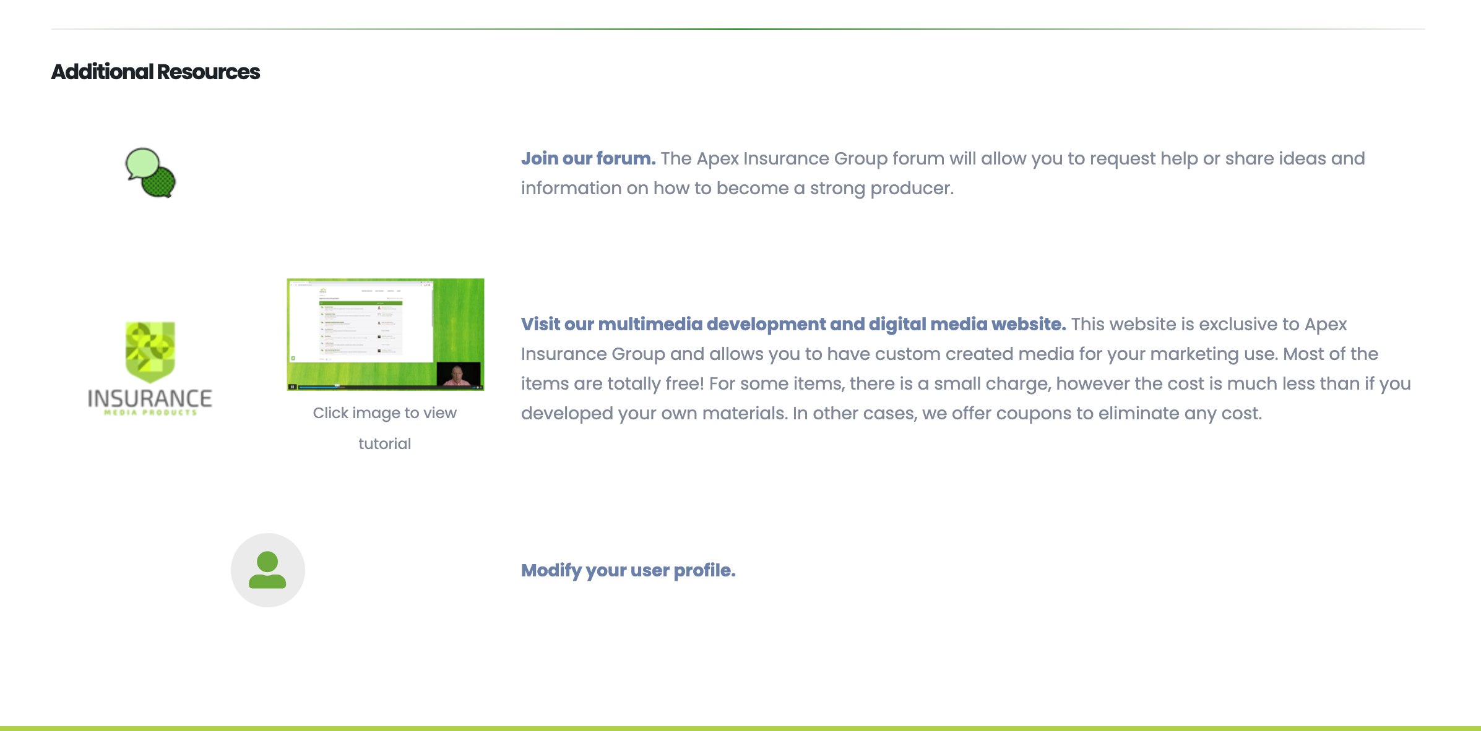
Agent Services:
Landing page
6
8
SUGGESTED FIX:
8
7
Whether in an accordion section or not:
Add a headline for this section, and update the links.
Have only one image/icon/thumbnail per resource to keep the sections balanced.
Fix links to be accessible and SEO-friendly.
Consider moving “Modify User Profile” to it’s own accordion link, since it doesn’t really fit the same “Additional Resources” category of the other two.
9

